Slide 1
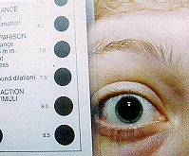
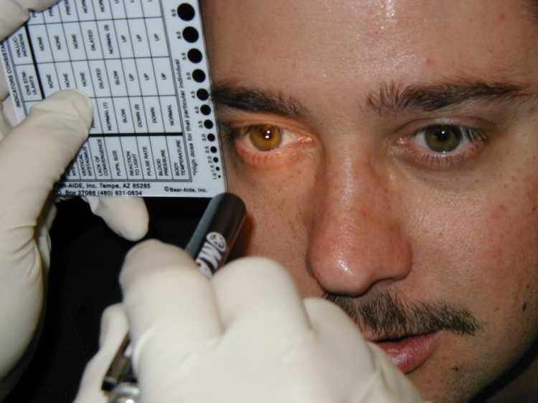



Session 4
The Eye Examinations

Slide 2
Learning Objectives
Administer tests of HGN, VGN, and LOC
Estimate pupil size
Relate the expected results of the eye examinations

Slide 3
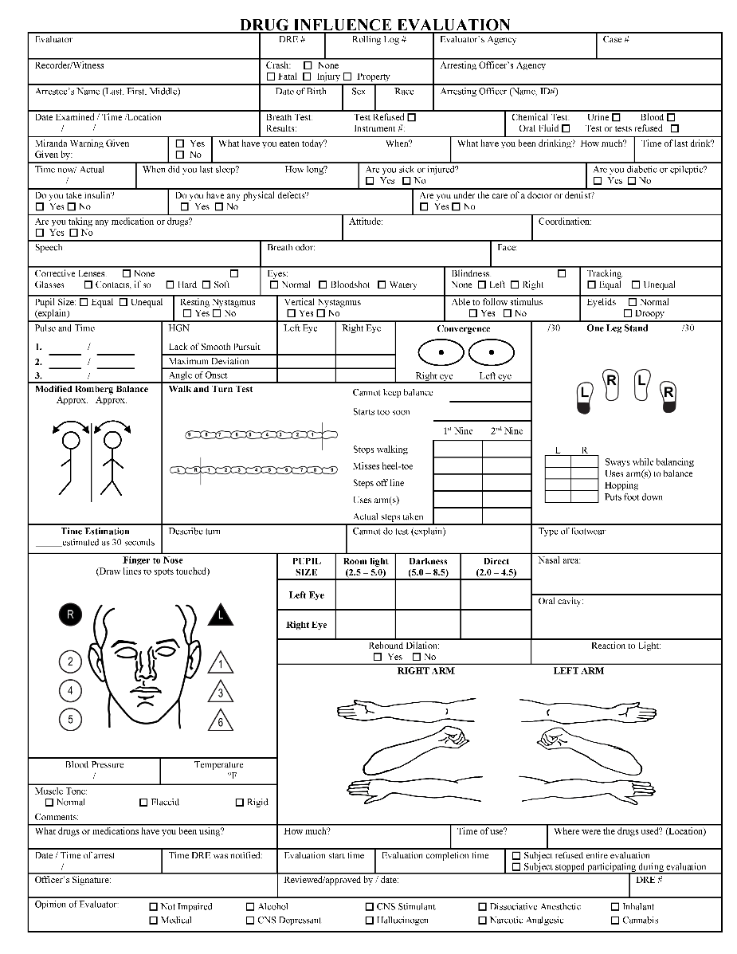
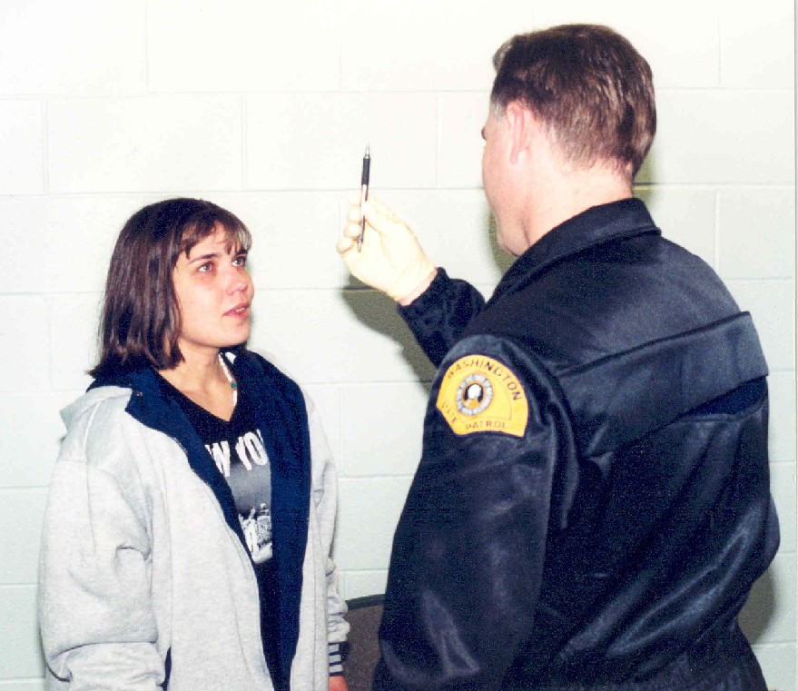
Eye Examination Purpose

Slide 4
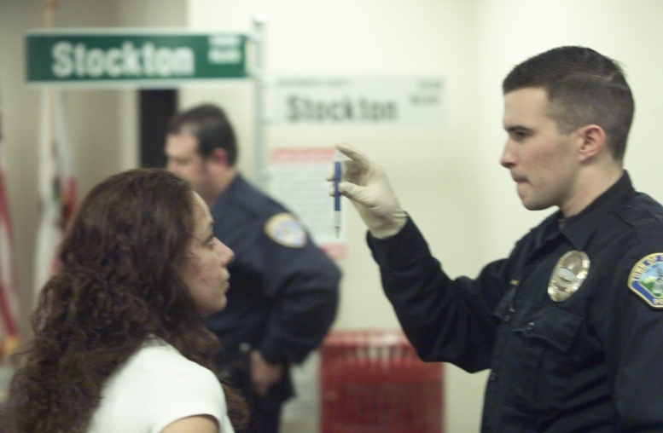
Eye Examination – Horizontal Gaze Nystagmus

Slide 5
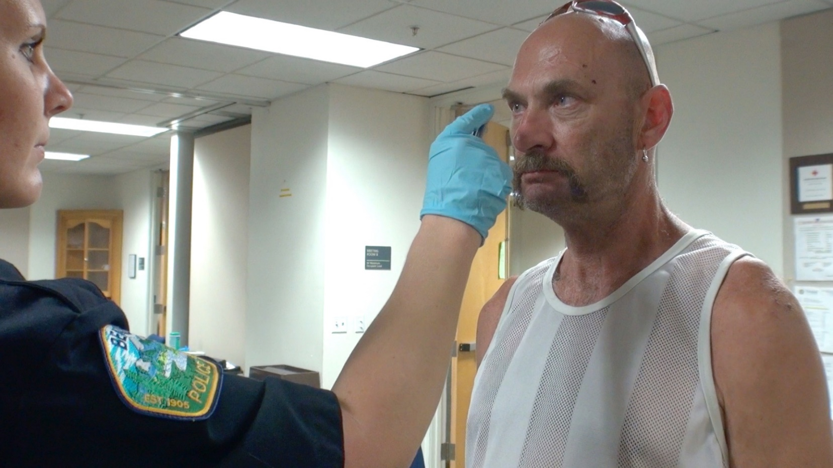
Eye Examination – Horizontal Gaze Nystagmus

Slide 6
Three Clues of Horizontal Gaze Nystagmus
Lack of Smooth Pursuit
Distinct and Sustained Nystagmus at Maximum Deviation
Angle of Onset

Slide 7

Lack of Smooth Pursuit

Slide 8
Participant Practice
Lack of Smooth Pursuit

Slide 9
Distinct and Sustained Nystagmus at Maximum Deviation

Slide 10

Three Clues of Horizontal Gaze Nystagmus
Angle of Onset

Slide 11
Angle of Onset
BAC = 50 – Angle of Onset
Angle of Onset = 35 degrees
= 50 – 35
= 0.15

Slide 12
Angle of Onset

Slide 13
Horizontal Gaze Nystagmus
Standardization
Medical Complications

Slide 14
Vertical Gaze Nystagmus

Slide 15
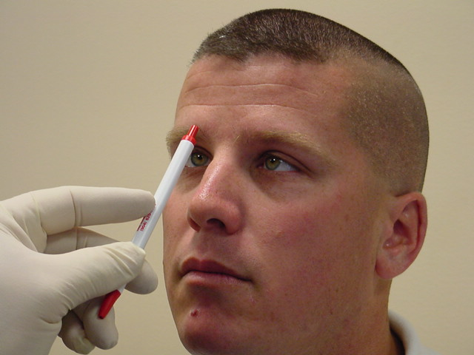
Lack of Convergence

Slide 16
Lack of Convergence Testing Procedure
Examiner
Subject

Slide 17
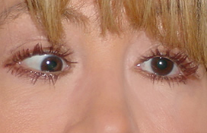
Normal convergence is a distance approximately two inches (2”) from bridge of nose

Slide 18
Drug Categories That Cause Lack of Convergence
CNS Depressants
Inhalants
Dissociative Anesthetics
Cannabis

Slide 19
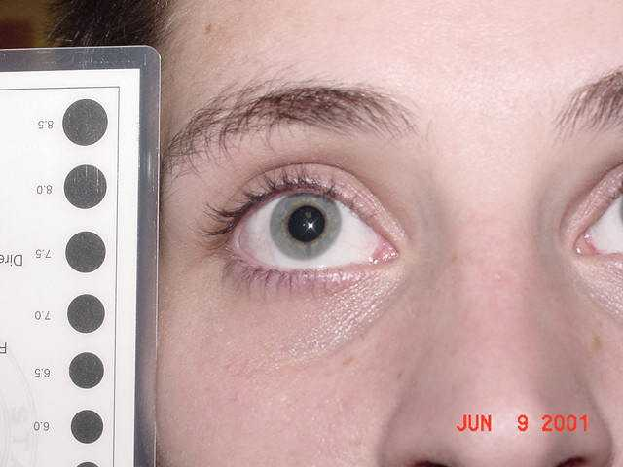
Estimating Pupil Size

Slide 20
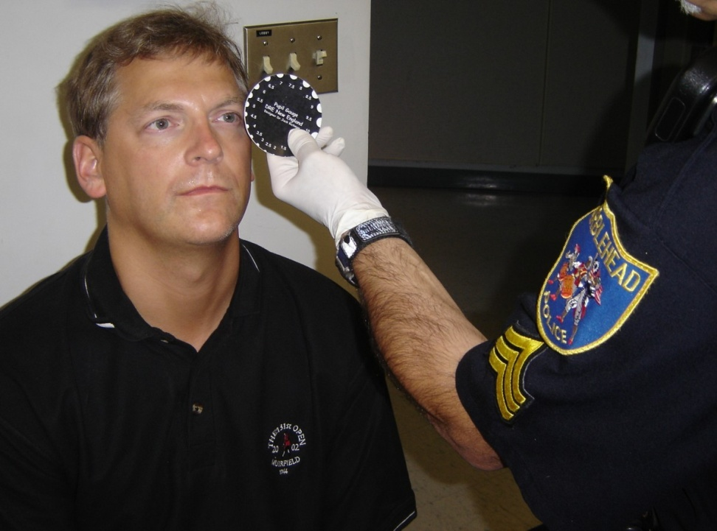
Estimating Pupil Size

Slide 21
Estimating Pupil Size
DRE average range of pupil size in room light is 2.5 to 5.0 mm

Slide 22
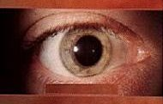
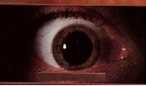
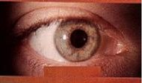
Three Testing Conditions for Pupil Size Estimations
Room Light
Near Total Darkness
Direct Light

Slide 23
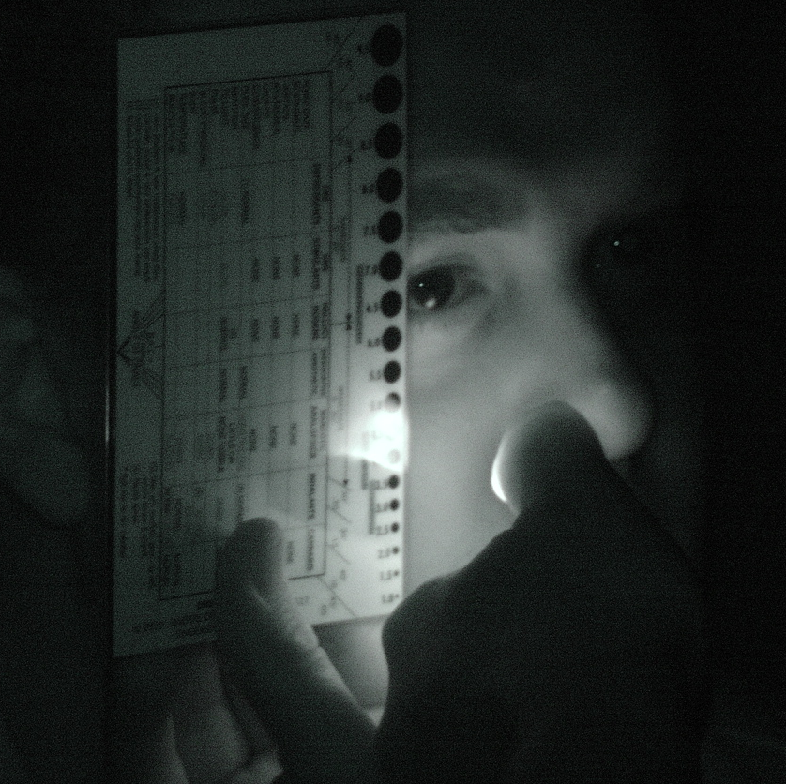
Estimation of Pupil Size

Slide 24
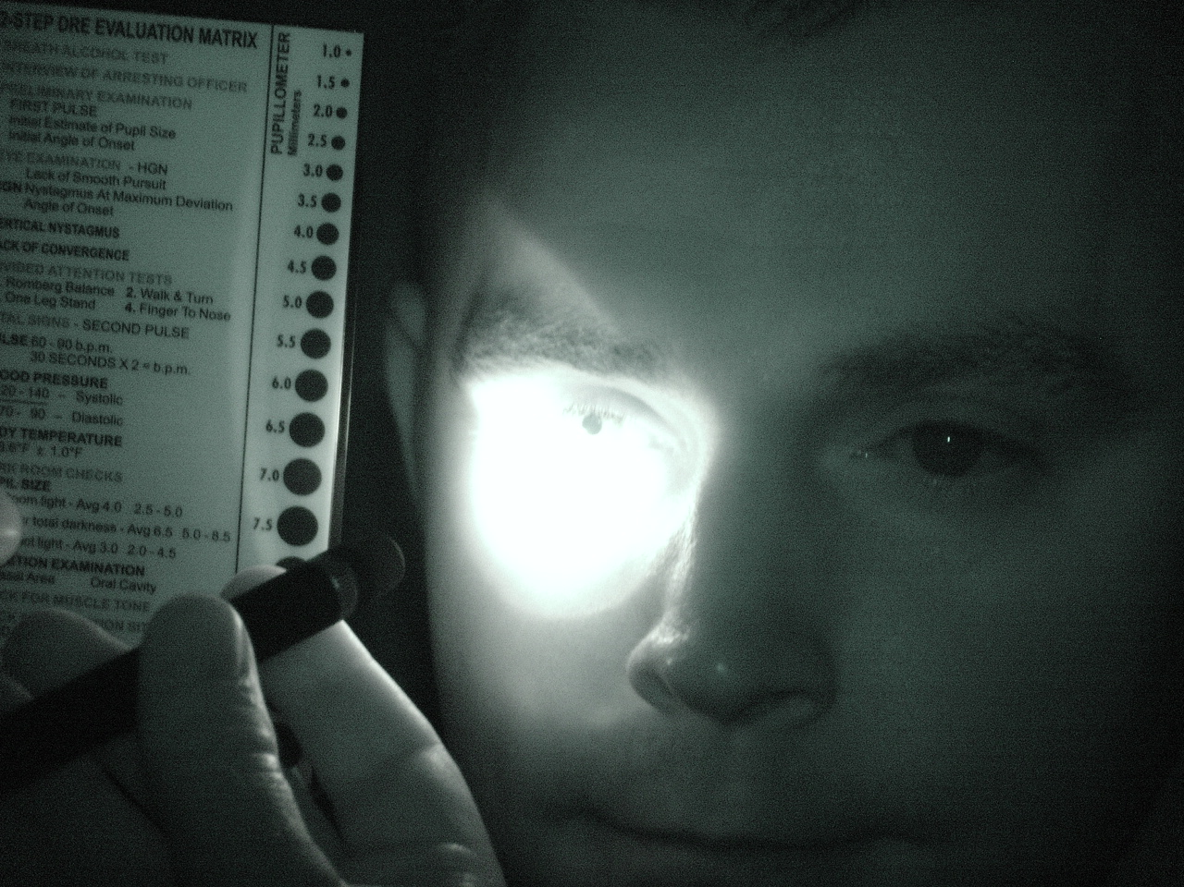
Estimation of Pupil Size Darkroom Demonstrations

Slide 25
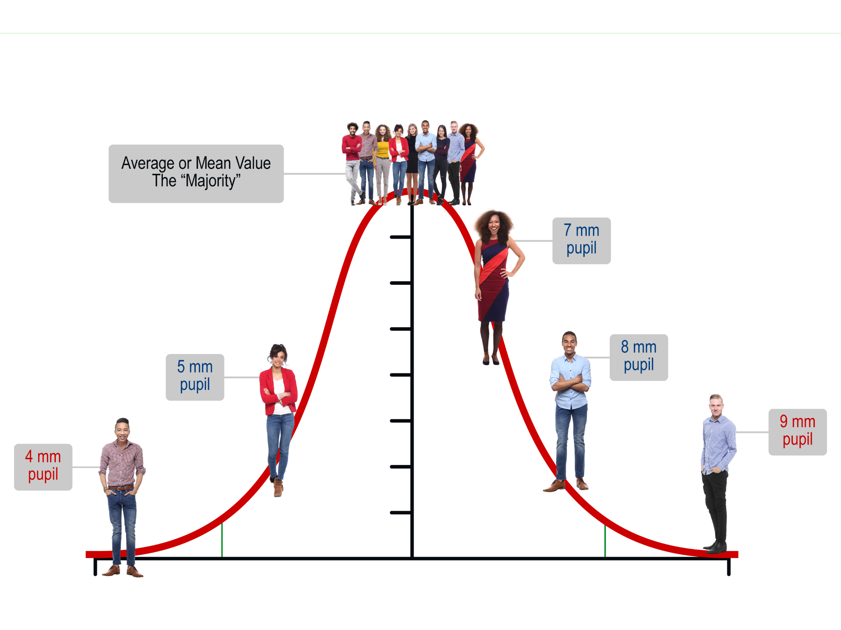
Average-Normal-Expected Value

Slide 26


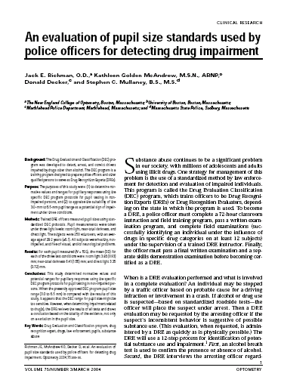
Updated Values – Where did they come from specifically related to DRE?

Slide 27
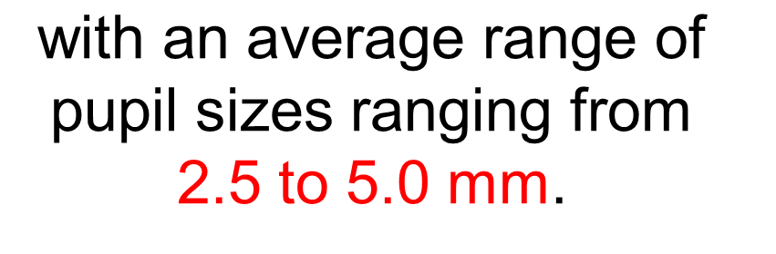
Room Light
10.0 mm 0.00%
9.5 mm 0.00%
9.0 mm 0.00 %
8.5 mm 0.00%
8.0 mm 0.00%
7.5 mm 0.45%
7.0 mm 1.12%
6.5 mm 1.79%
6.0 mm 0.89%
5.5 mm 3.35%
5.0 mm 4.24%
4.5 mm 13.17%
4.0 mm 23.66%
3.5 mm 24.11%
3.0 mm 18.08%
2.5 mm 5.36%
2.0 mm 0.89%
1.5 mm 0.00%
1.0 mm 0.00%
Room Light is approximately 4.0 mm

Slide 28
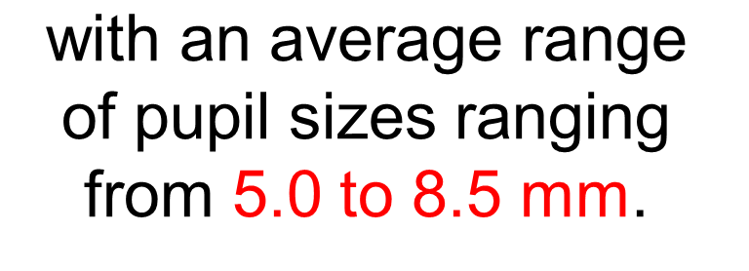
Near Total Darkness
10 mm 0.00%
9.5 mm 0.22%
9 mm 4.80%
8.5 mm 6.92%
8 mm 8.93%
7.5 mm 11.00%
7 mm 14.07%
6.5 mm 15.17%
6 mm 13.02%
5.5 mm 10.00%
5 mm 8.93%
4.5 mm 4.47%
4 mm 1.79%
3.5 mm 1.00%
3 mm 0.00%
Near Total Darkness is approximately 6.5 mm

Slide 29
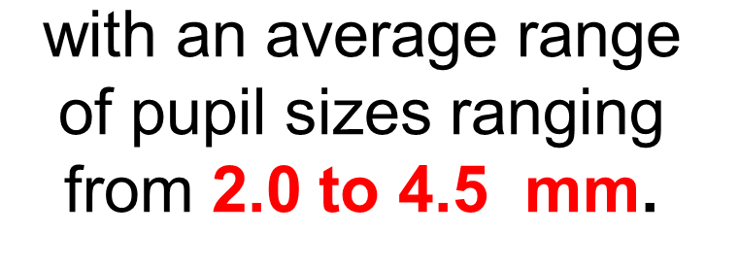
Direct Light
10.0 mm 0.00%
9.5 mm 0.00%
9.0 mm 0.00 %
8.5 mm 0.00%
8.0 mm 0.00%
7.5 mm 0.44%
7.0 mm 1.12%
6.5 mm 0.89%
6.0 mm 1.79%
5.5 mm 3.35%
5.0 mm 4.24%
4.5 mm 13.17%
4.0 mm 23.66%
3.5 mm 24.11%
3.0 mm 21.08%
2.5 mm 5.36%
2.0 mm 0.89%
1.5 mm 0.00%
1.0 mm 0.00%
Direct Light is approximately 3.0 mm

Slide 30
Reaction to Light
Assessment of how quickly pupil constricts to its smallest size during check of pupil size under direct light.

Slide 31
Pupil Reaction Time
Normal
Slow

Slide 32
Pupil Reaction Time
Participant Practice

Slide 33
Equal Tracking
Equal Pupil Size
Horizontal Gaze Nystagmus
Participant Practice

Slide 34
Vertical Gaze Nystagmus
Lack of Convergence
Participant Practice

Slide 35
Pupil Size
Reaction to Light
Participant Practice

Slide 36
Pupil Size Ranges Recap
Room Light: 4.0 mm
Average range of 2.5 – 5.0 mm
Near Total Darkness: 6.5 mm
Average range of 5.0 – 8.5 mm
Direct Light: 3.0 mm
Average range of 2.0 – 4.5 mm

Slide 37
Relationship of Drug Categories to the Eye Examinations
 | CNS Depressants | CNS Stimulants | Halluci-nogens | Dissociative Anesthetics | Narcotic Analgesics | Inhalants | Cannabis
HGN
VGN
LOC
Pupil Size
Reaction to Light
Present
None
None
Present
None
Present
None
Present
None
None
Present
None
Present
None
Present
None
None
Present
None
Present
Present
FOOTNOTE: These indicators are those most consistent with the category, keep in mind there may be variations due to individual reaction, dose taken and drug interactions.

Slide 38
Relationship of Drug Categories to the Eye Examinations
 | CNS Depressants | CNS Stimulants | Halluci-nogens | Dissociative Anesthetics | Narcotic Analgesics | Inhalants | Cannabis
HGN
VGN
LOC
Pupil Size
Reaction to Light
Present
None
None
Present
None
Present
None
Present
None
None
Present
None
Present
None
Present
None
None
Present
None
Present
Present
Normal (1)
Dilated
Dilated
Normal
Constricted
Normal (4)
Dilated (6)
FOOTNOTE: These indicators are those most consistent with the category, keep in mind there may be variations due to individual reaction, dose taken and drug interactions.
(1) Soma, Quaaludes and some antidepressants usually dilate pupils.
(4) Possibly dilated.
(6) Possibly normal.

Slide 39
Relationship of Drug Categories to the Eye Examinations
 | CNS Depressants | CNS Stimulants | Halluci-nogens | Dissociative Anesthetics | Narcotic Analgesics | Inhalants | Cannabis
HGN
VGN
LOC
Pupil Size
Reaction to Light
Present
None
None
Present
None
Present
None
Present
None
None
Present
None
Present
None
Present
None
None
Present
None
Present
Present
Normal (1)
Dilated
Dilated
Normal
Constricted
Normal (4)
Dilated (6)
Slow
Slow
Normal
Normal
Little or None Visible
Slow
Normal
(3)
FOOTNOTE: These indicators are those most consistent with the category, keep in mind there may be variations due to individual reaction, dose taken and drug interactions.
(1) Soma, Quaaludes and some antidepressants usually dilate pupils.
(6) Possibly normal.
(3) Certain psychedelic amphetamines may cause slowing.
(4) Possibly dilated.

Slide 40
Questions?

Slide 41
Test Your Knowledge
Name the three clues of impairment associated with HGN.
Complete this formula: BAC = 50 - ????
Which categories of drugs will not cause VGN?
Which categories of drugs usually will cause LOC?

Slide 42
Test Your Knowledge
Name the three lighting conditions under which a DRE makes pupil size estimations.
What is the average range of pupil size in room light?
Which categories of drugs will usually slow down the reaction of pupils to light?

